Slide 1
What will I get out of doing research?
Presented by Alexander Bruckhaus
USC Mark and Mary Stevens Neuroimaging and Informatics Institute
Keck School of Medicine of USC
University of Southern California

Slide 2
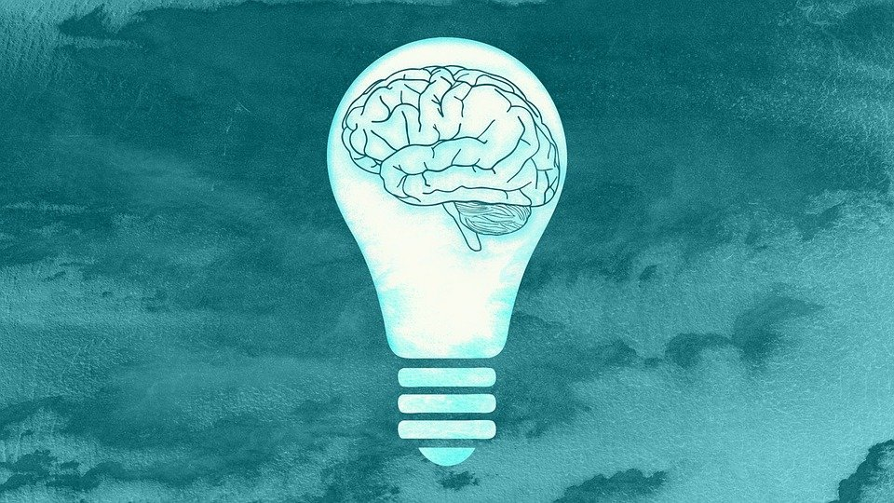
Introduction
Beyond the extensive subject knowledge you will gain from performing research, you will be in an environment with many, many bright minds such as your peers, faculty, and other researchers that help tremendously with guidance and advice, not only pertaining to research.
USC Mark and Mary Stevens Neuroimaging and Informatics Institute
Keck School of Medicine of USC
University of Southern California

Slide 3
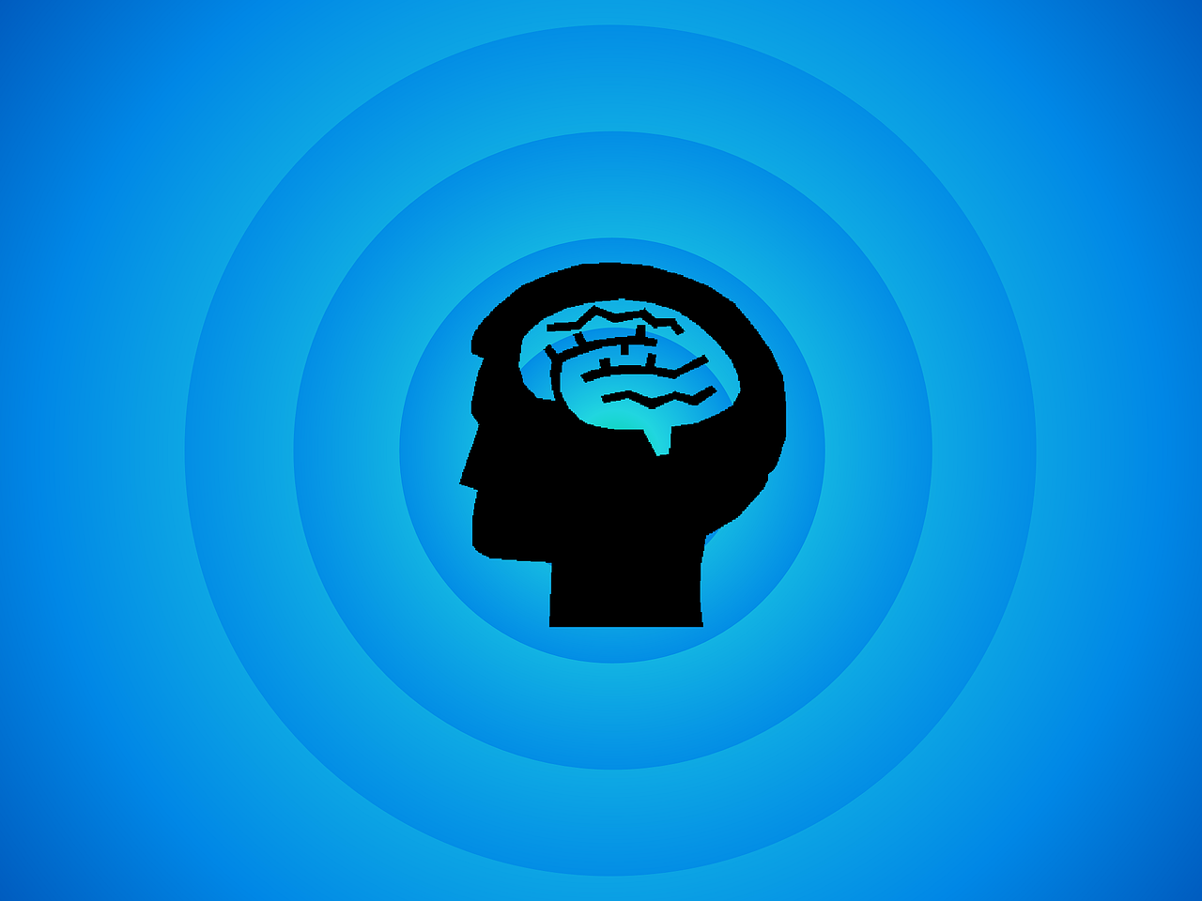
More than just your subject domain
Overall research process
Understanding how knowledge is disseminated in the scientific community
Technical/Analytical skills
Public speaking skills
Presenting your work to peers
Critical thinking skills
Writing skills
Working/communicating in teams
Other people’s ideas/expertise
Developing professional relationships
Possible publication(s)!
USC Mark and Mary Stevens Neuroimaging and Informatics Institute
Keck School of Medicine of USC
University of Southern California

